Slide 1

“Pay No Dough If It Doesn’t Snow!”
Program Statistics Analysis
Present By: Caner Irfanoglu, Diven Sambhwani, Madeleine Leong, Sreeraj Punnoli and Tom Tong
September 13th, 2018

Slide 2


Contents
Normality Test
Perform Visual Examination, Shapiro–Wilk Test, P-P & Q-Q Test
02
Refund Probabilities
Calculate the refund probabilities for London, Toronto & Vancouver
01
Should Firestone Go?
The conclusion: should Firestone go with this program
05
Official Mean Computation
How the official mean is computed affect the refund probabilities
03
04
Expected Value
The expected value to the consumer in each cities

Slide 3
Visual Examination of Normal Distribution
Figure: Histograms of Snow Depth vs. Frequencies in Given Cities

Slide 4

Shapiro- Wilk Normality Test
City | p-value | Significant
Toronto | 0.586 | No
London | 0.079 | No
Vancouver | 0.003 | Yes
Table: Shapiro- Wilk Test Results

Slide 5
Probability-Probability Plots & Quantile-Quantile Plots

Slide 6
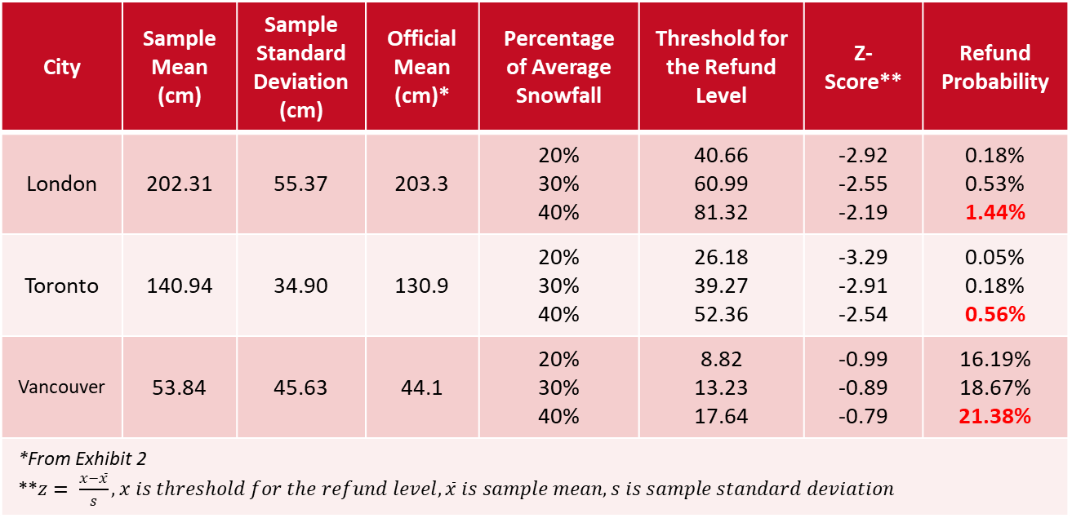
What Are The Refund Probabilities?
City | Sample Mean (cm) | Sample Standard Deviation (cm) | Official Mean (cm)* | Percentage of Average Snowfall | Threshold for the Refund Level | Z-Score** | Refund Probability
London | 202.31 | 55.37 | 203.3 | 20% 30% 40% | 40.66 60.99 81.32 | -2.92 -2.55 -2.19 | 0.18% 0.53% 1.44%
Toronto | 140.94 | 34.90 | 130.9 | 20% 30% 40% | 26.18 39.27 52.36 | -3.29 -2.91 -2.54 | 0.05% 0.18% 0.56%
Vancouver | 53.84 | 45.63 | 44.1 | 20% 30% 40% | 8.82 13.23 17.64 | -0.99 -0.89 -0.79 | 16.19% 18.67% 21.38%
*From Exhibit 2 **$z= \frac{x−\overline{x}}{s}, x is threshold for the refund level, \overline{x} is sample mean, s is sample standard deviation$

Slide 7
Average Snowfall in cm
 | Last 10 Years | All Years | Toro’s Interval
Toronto | 130.9 | 141.0 | 139.2
Vancouver | 44.1 | 53.8 | 60.3
London | 203.3 | 202.3 | 208.8
“Official mean” is calculated on basis of last 10 years data
If the mean is lower that means there is less snowfall and so the company has to pay less refund.

Slide 8
Probability of Getting Refund
 | Last 10 Years | All Years | Toro’s Interval
Toronto | 0.56% | 0.77% | 0.73%
Vancouver | 21.4% | 23.9% | 25.8%
London | 1.44% | 1.42% | 1.60%
Yes, the way in which the official mean is computed do affect the refund probabilities.

Slide 9
The Expected Value to the Consumer in Each Cities
In probability theory, the expected value of a random variable, intuitively, is the long-run average value of repetitions of the experiment it represents. Expected value is the sum of all of the possible outcomes by the probability of it happening.
Expected Value = Sum of (Possible outcomes*Probability)
Expected value of refund would be:
Expected Value(Ref) = 0 % of Cost of Tyre * (Probability of snowfall > 40% of the average) +
50% of Cost of Tyre * (Probability of snowfall < 40% and > 30% of the average) +
75% of Cost of Tyre * (Probability of snowfall < 30% and > 20% of the average) +
100% of Cost of Tyre * (Probability of snowfall < 20% of the average)
Expected Value of Customer Has to pay would be:
Expected Value(Pay) = 100 % of Cost of Tyre * (Probability of snowfall > 40% of the average) +
50% of Cost of Tyre * (Probability of snowfall < 40% and > 30% of the average) +
25% of Cost of Tyre * (Probability of snowfall < 30% and > 20% of the average) +
0 % of Cost of Tyre * (Probability of snowfall < 20% of the average)

Slide 10
Toronto
Let C be the Cost of the Tyre.
Expected Value (Pay)= C * (Probability of snowfall > 40% of the average) +
0.5 * C * (Probability of snowfall < 40% and > 30% of the average) +
0.25*C * (Probability of snowfall < 30% and > 20% of the average) +
0 * C * (Probability of snowfall < 20% of the average)
= C * 0.999033814 + 0.5 * C * 0.000817267 + 0.25 * C * 0.000131087 + 0 * C * 0.000017832
= C * 0.999
Expected Value (Ref) = 0 * C * (Probability of snowfall > 40% of the average) +
0.5 * C * (Probability of snowfall < 40% and > 30% of the average) +
0.75 * C * (Probability of snowfall < 30% and > 20% of the average) +
1 * C * (Probability of snowfall < 20% of the average)
= 0*C * 0.999033814 + 0.5*C * 0.000817267 + 0.75*C * 0.000131087 +1*C * 0.000017832
= C * 0.000524781
So the Expected Value of Refund is 0.05 % of the Cost of the Tyre.

Slide 11
Vancouver
Expected Value (Ref) = 0 * C * (Probability of snowfall > 40% of the average) +
0.5 * C * (Probability of snowfall < 40% and > 30% of the average) +
0.75 * C * (Probability of snowfall < 30% and > 20% of the average) +
1 * C * (Probability of snowfall < 20% of the average)
=0*C * 0.805018034 + 0.5*C * 0.037042667 + 0.75*C * 0.032092134 +1*C * 0.125847165
= C * 0.1684
Expected Value (Pay) = 1 * C - Expected Value (Ref)
= 1 * C - C * 0.1684
= C * 0.8316
So the Expected Value of Refund is 16.84 % of the Cost of the Tyre.

Slide 12
London
Expected Value (Ref) = 0 * C * (Probability of snowfall > 40% of the average) +
0.5 * C * (Probability of snowfall < 40% and > 30% of the average) +
0.75 * C * (Probability of snowfall < 30% and > 20% of the average) +
1 * C * (Probability of snowfall < 20% of the average)
=0*C * 0.974898309 + 0.5*C * 0.013933491 + 0.75*C * 0.006653901 +1*C * 0.004514299
= C * 0.01647
Expected Value (Pay) = 1 * C - Expected Value (Ref)
= 1 * C - C * 0.01647
= C * 0.98353
So the Expected Value of Refund is 0.016 % of the Cost of the Tyre.

Slide 13

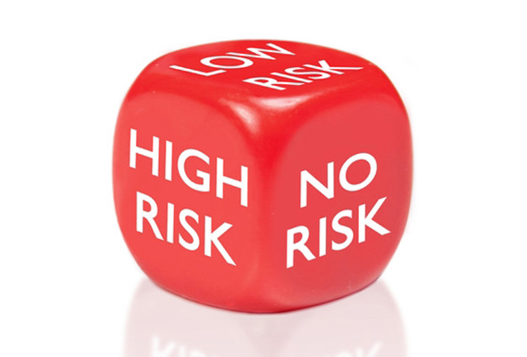

Should Firestone Execute This Program?
Sales Promotion Benefits
Promote Name Awareness
Attract Customer Traffic
Potential Boost Sales
Sales Promotion Risks
Potential Loss Revenue
Reduce Profit Margin
May Hurt Company Reputation
Profit Over the Program
$15,000,000.00 Profit Last Year
$500,000.00 Total Program Cost
10,000 to 20,000 Anticipated Tires for 2.5 Months

Slide 14


Case Expanding
LOO

Slide 15
Thank You!

